Slide 1
COSC2446: Web Programming
HTML

Slide 2
HTML
HyperText Markup Language

Slide 3
Some History
HTML was created around 1990 by Sir Tim Berners-Lee, to make it easier for scientists to share research papers.
He created HTTP, HTML, and wrote the first web server and browser software.
Sir Tim is currently director of the W3C – the World Wide Web Consortium.
W3C Website

Slide 4
HTML
Defines the content and structure of a web page

Slide 5
HTML – Content
Content is the information on the page
Text
Images
Audio
Video

Slide 6
HTML - Structure
Structure organises the content in a meaningful way.
Headings
Paragraphs
Lists
Links
Tables

Slide 7
Markup
HTML uses tags to specify structure. A tag is a word or abbreviation inside angle brackets, and frequently comes as a matched pair of opening and closing tags, for example
<p>This is a paragraph</p>
<p> is the opening tag for a paragraph element.
</p> is the closing tag for that element.

Slide 8
The HTML Language
HTML has a set of elements (specified by tags) defined by the W3C – the World Wide Web Consortium.
For a valid HTML document you must use the tags defined by the specification.

Slide 9
W3Schools
W3Schools.com is an excellent website with references and tutorials on HTML and many other web languages. Check it out for a list of the available HTML elements, and how to use them.
W3Schools website

Slide 10
Versions
The current version of HTML is HTML5. In order to validate an HTML document we must state which version it is. This is done with the DOCTYPE declaration at the start
<!DOCTYPE html>
Even though this doesn’t mention 5 anywhere, it is different from all previous versions of HTML and the related specification XHTML.

Slide 11
Validation
The W3C provides a web page validation service at http://validator.w3.org
You can upload an html file or enter code directly.

Slide 12
Editing HTML
Modern IDEs

Slide 13
How to write HTML
HTML is essentially a text that can be written in various editors, including Notepad, Textpad, etc.
But new modern Integrated Development Environments (IDE) can do so much more.

Slide 14
Advantages of modern IDEs
IDEs can do:
syntax highlighting
bracket-matching
auto-indentation
box-selection
snippets
debugging
support multiple languages
and more.

Slide 15
Examples of IDEs
Visual Studio Code (preferred)
Eclipse
Sublime
Atom
BBEdit
Brackets
RJ TextEd
Light Table
Komodo Edit

Slide 16
HTML and Web Servers
How to display HTML pages

Slide 17
Displaying in a browser
An html page can be viewed directly in a browser:
Open a browser (preferably Chrome – has developer capabilities)
Select File -> Open File. Learn to use shortcuts – ctl+O for Windows or command+O for Macs.
Find the correct file in your file system
View the file

Slide 18
Displaying via a Webserver
Your html files will be hosted on a webserver.
Web server is a program which processes the network requests of the users and serves them with files that create web pages. This exchange takes place using Hypertext Transfer Protocol (HTTP).
You will need an address – DNS entry – and the name of the file.

Slide 19
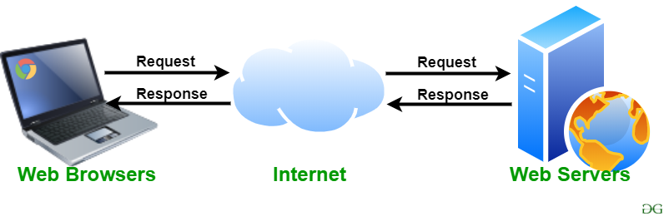
HTTP request/response cycle
https://www.geeksforgeeks.org/web-server-and-its-type/

Slide 20
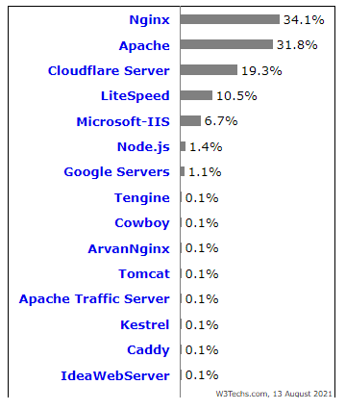
Common webservers

Slide 21
RMIT webservers - Coreteaching
You will be deploying all of your assessments on the RMIT webservers – Jupiter/Saturn/Titan (they all share the same file server):
Linux servers
Apache
Address https://jupiter.csit.rmit.edu.au/~s123456 (~ and your student number)
Use git pull to deploy files to Coreteaching. You should have already cloned the wp repository

Slide 22
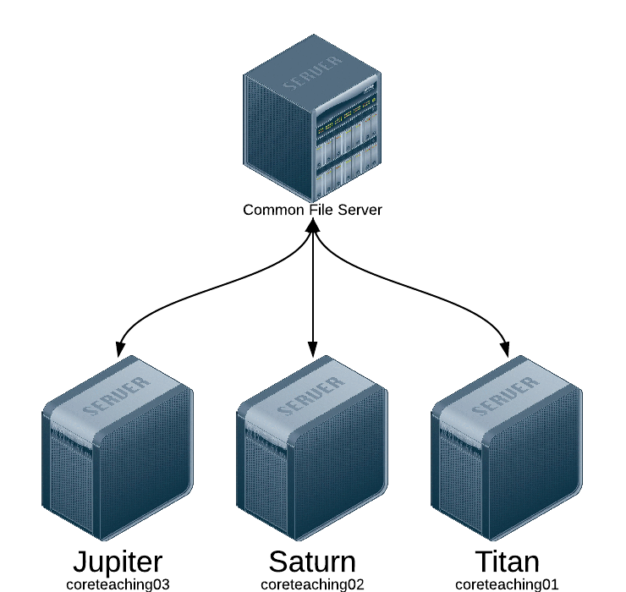
Coreteaching servers

Slide 23
What do you need to use Coreteaching servers
A program like PuTTY (Windows) or Terminal (McOS)
Access to Coreteaching – please raise an IT ticket if you can’t access it
Create a folder called public_html in the root folder of your home directory. Give it permissions 755.

Slide 24
The Elements of HTML
Elements and tags used in a Web Page

Slide 25
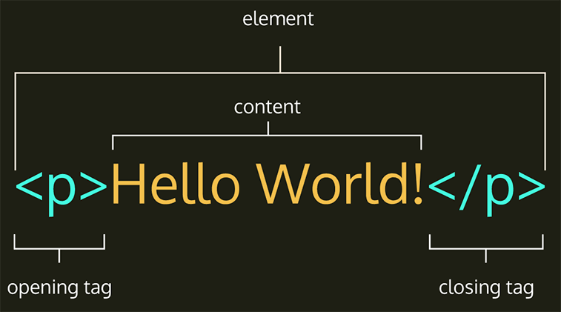
Elements
https://vegibit.com/wp-content/uploads/2022/03/html-tag-diagram.png

Slide 26
The html element
The html element is known as the root element. There can only be one html element in a page, and it must contain (between the opening and closing tag) all the other elements of the page.

Slide 27
DOCTYPE
The doctype declaration is not an element, and goes before the html element in the page
<!DOCTYPE html>
<html>
…other content
</html>

Slide 28
The head and body elements
Inside the html element we have one head element and one body element, in that order.
Note that browsers will display parts of web pages that are incomplete or incorrectly written, so don’t assume that if a browser displays it it must be OK.
The only way to be sure a page is correct is to validate it.

Slide 29
<!DOCTYPE html>
<html>
<head>
…content of head
</head>
<body>
…content of body
</body>
</html>

Slide 30
Points to Note
Use indentation to help readability (set “Format on Save” and “Format on Paste” in VS Code settings)
Additional content is either inside the head or inside the body – there should be no other elements directly inside the html element
Elements should be nested properly – in this example, we need to close the head element before opening the body element

Slide 31
The title and the character encoding
The head element must contain a title element, which itself contains some text (the title on the browser tab)
The character encoding can be specified, usually with a meta tag in the head, which has an attribute for the character encoding. We will discuss attributes in detail shortly. The default HTML5 encoding is UTF-8

Slide 32
Required head elements
<!DOCTYPE html>
<html>
<head>
<title>Home Page</title>
</head>
<body>
…body content here
</body>
</html>
html_01
(right click on the web page and select View Page Source to see code)

Slide 33
Closing tag not always required
On the previous slide the meta element did not have a closing tag. The meta element cannot contain content (between opening and closing tags) and a closing tag is not required in this case.

Slide 34
Content
Content of an element appears between its opening and closing tag
Content can be other elements
Content can be text
Content can be images or media
Not every element has content

Slide 35
Content continued
The content of the html element is one head element and one body element

Slide 36
Content continued
The content of the head element is a title and a meta element. There may be other elements in the head
The content of the title element is text
There is no content for the meta element

Slide 37
Content of the body element
The body element does not have to have any content, however, this is where the visible content of a web page goes.
Generally, the body contains headings (as h1, h2, etc.), paragraphs (p elements), lists, images, hyperlinks, tables, and information presented in various other ways.
The body may also contain elements whose sole job is to organize the content in various ways.

Slide 38
Headings
HTML has six levels of heading, using the elements h1, h2, h3, h4, h5 and h6.
h1 represents a top-level heading and is generally rendered by the browser as a large bold font.
There is general agreement amongst browser vendors to be consistent as to how these elements are rendered so pages look pretty much the same in different browsers.

Slide 39
Subheadings
h2 is a second level heading or sub-heading.
Further levels (h3 – h6) are sub-sub-headings, etc. It is very rare for a web page to use heading levels past h3.

Slide 40
Paragraphs
The p element is used for paragraph text. For two or more paragraphs you need two or more p elements – a browser won’t display a line feed inside a single p element.
Example_01_02

Slide 41
Lists
ol is the element for an ordered list, also known as a numbered list. The order of items in the list may be important.
ul is the element for an unordered list, also known as a bulleted list. It is assumed that the order of items in the list is not important
both ol and ul contain item elements as li. The browser provides the numbering or bullets.

Slide 42
Days of the Week (ordered list)
<ol>
<li>Sunday</li>
<li>Monday</li>
<li>Tuesday</li>
<li>Wednesday</li>
<li>Thursday</li>
<li>Friday</li>
<li>Saturday</li>
</ol>
html_03 (ordered list)
html_04 (unordered list)

Slide 43
Description List
The dl (description list) element contains dt (description term) and dd (description definition) elements. There can be any number of either of these.
General usage is to have one term dt and then one or more definition dd elements to explain what the term means, like a glossary.

Slide 44
Glossary of Web Languages
<dl>
<dt>HTML</dt>
<dd>Hypertext Markup Language</dd>
<dd>Defines structure and content of a web page</dd>
<dt>CSS</dt>
<dd>Cascading Style Sheets</dd>
<dd>Language for style and layout</dd>
</dl>
html_05

Slide 45
ATTRIBUTES
Attributes – inside the opening tag

Slide 46
Attributes and Content
Attributes and content are two different ways to include data in an html element.
Some elements use content (e.g. h1, p) and may also contain attributes.
Some elements must use attributes for important content, such as the URL of a hyperlink or the source file for an image
We have already seen the meta element in the head, which uses the charset attribute

Slide 47
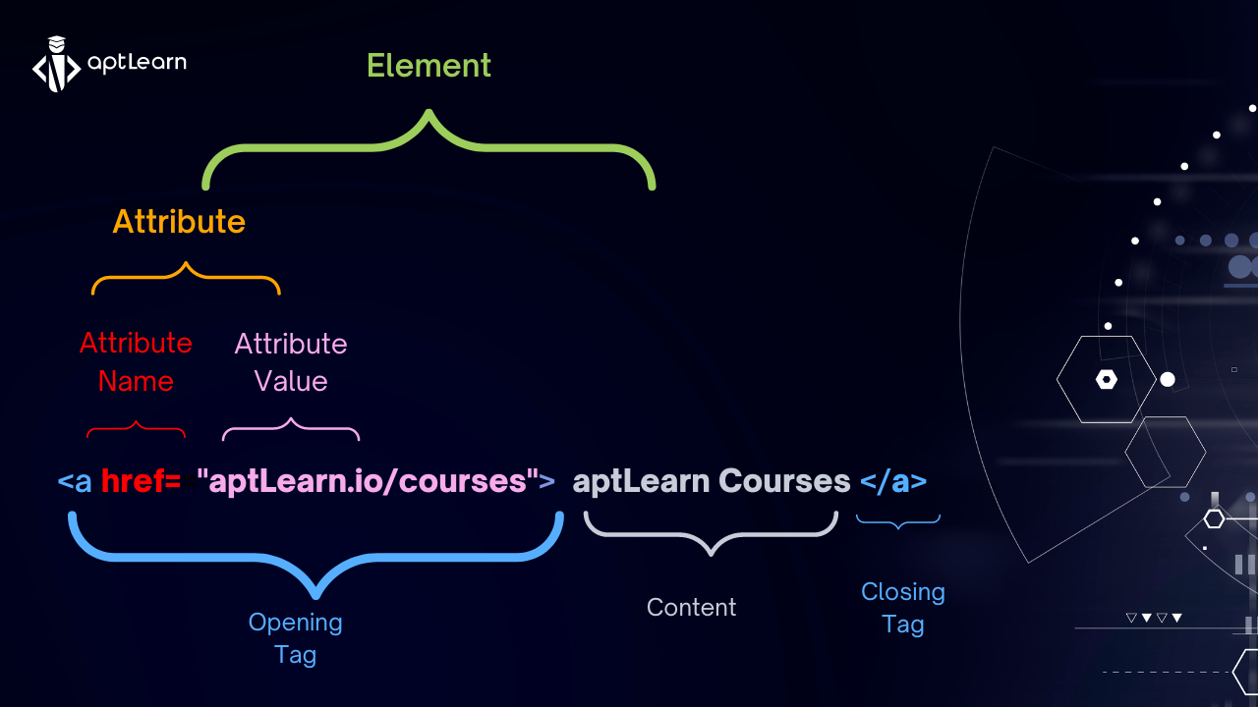
Attributes and Content

Slide 48
General form of an element with attributes
<element attribute="value">Content</element>
There isn’t an element called ‘element’ of course, this is just to show how this kind of element is written

Slide 49
Hyperlinks
The a element is used for a hyperlink.
<a href=http://www.google.com>Google</a>
a is the name of the element and appears at the start of the opening tag and in the closing tag
Google is the content, between the opening and closing tags
href is an attribute, inside the opening tag but not at the start
the URL is the value of the attribute
html_06

Slide 50
Images
An img element (for image) is another element that uses attributes. In fact, it is not permitted to have any content in an img element, so a closing tag is not required
<img src="background.jpg">
This will display the image background.jpg if it is in the same directory as the web page.
This code is not valid html, which requires an alt attribute with some text to describe the image for vision-impaired people. There may also be width and height attributes.

Slide 51
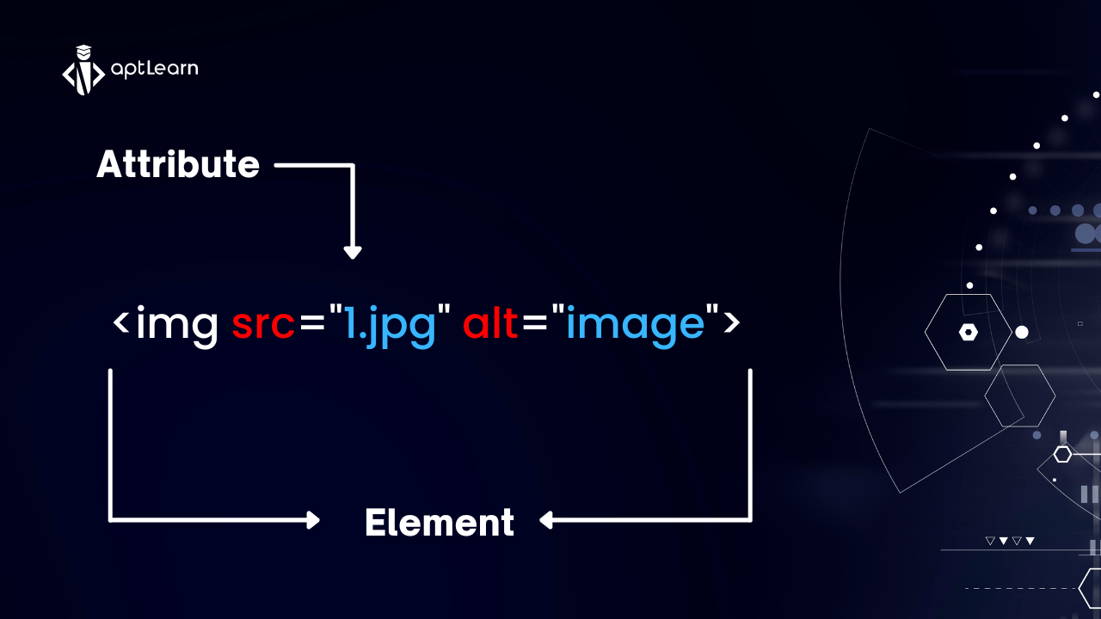
Images

Slide 52
Web page with image
html_07

Slide 53
Video
A video can be included in your web page with the video element. It has a src attribute with the name of the media file. All modern browsers can play mp4 videos, so I suggest you stick with that.
<video src="myvideo.mp4" controls></video>
The attribute 'controls' does not have a value. This is because the attribute name and its value are the same.

Slide 54
Example of Video
html_15

Slide 55
Tables
The table element contains tr (table row) elements. Each tr contains one or more td (table data) elements. There are no columns as such, but browsers display the td elements in different rows one under the other to give the appearance of columns.
The first row (tr) may contain th instead of td, for column headings. The are formatted differently (bold and centred) but otherwise act just like td.
html_08

Slide 56
Block elements
A block element starts on a new line, and is followed by a new line. Common block elements are all the headings (h1 – h6), p, all the list elements and the list items (li), table and each tr.
Note that in html_02 all the headings and paragraphs start on a new line.

Slide 57
Inline elements
An inline element does not start on a new line nor is it followed by one. Common inline elements are the a element (hyperlink), img, and td within tables.
Note that in html_06 all the links are on the same line in the web page, even though they are all on different lines in the HTML file.

Slide 58
The br element
The br element is used to force a line break in text or after elements that do not automatically produce line breaks. If we wanted the hyperlinks in Example 06 to each appear on a new line we could add a <br> tag after each one (no closing tag required).
html_09

Slide 59
Default values
Whether an element is block or inline is controlled by a property called display.
We can change this with CSS (next week's topic), so the previous slides are describing the default values, p is block, a is inline. It's quite common to change a elements to block instead of inline, for example in a narrow navigation sidebar.

Slide 60
Forms
A form is used to contain user interface widgets such as text boxes, radio buttons, drop-down menus. They are not much use without some scripting to work with the data that the user enters, so we will save them for later.
html_10

Slide 61
<select> and <option> tag
The <select> element is used to create a drop-down list.
<select name="cars" id="cars"> <option value="volvo">Volvo</option> <option value="saab">Saab</option> <option value="mercedes">Mercedes</option> <option value="audi">Audi</option> </select>
The <option> tags inside the <select> element define the available options in the drop-down list.

Slide 62
<!DOCTYPE html>
<html lang="en">
<head>
<title>Title</title>
</head>
<body>
<h1>The option element</h1>
<form action="#">
<label for="cars">Choose a car:</label>
<select id="cars">
<option value="volvo">Volvo</option>
<option value="saab">Saab</option>
<option value="opel">Opel</option>
<option value="audi">Audi</option>
</select>
</form>
</body>
</html>

Slide 63
Invisible elements
Many elements are not visible on a web page but are used to organize and format visible content. These include div, span, header, footer, section, main, aside and several others.
html_11 use div to centre content
html_12 use header and footer to style content
These examples contain some CSS which will be the subject for Week 3.

Slide 64
Semantic elements
Some invisible elements are semantic elements - a semantic element clearly describes its meaning to both the browser and the developer. These include header, footer, section, main, nav, aside, form, table, article and several others.
Some invisible elements are not semantic as the tell nothing about content. These include div, span and several others.
For more examples see W3Schools site

Slide 65
Folders, files and paths
Relative vs absolute

Slide 66
Website folders and files
When you are working on a website, you should keep all the related files in a single folder
Folder and file names should be lowercase with no spaces
Many computers (especially servers) are case-sensitive
Browsers, programs do not handle spaces the same way

Slide 67
Example Website structure
index.html – generally the home page. This page will be automatically loaded
images folder – contains all images used in your website
css (or styles) folder – contains css style sheets used to style your content
js (or scripts) folder – contains JavaScript code used to add interactive functionality

Slide 68
Folder structure and file paths
website Folder
To make files talk to one another, you have to provide a file path
We do this by telling the browser where the file is located (path) and the name of the file
images/tree.jpg
index.html
about.html
contact.html
images
tree.jpg
house.jpg
yellow.jpg

Slide 69
Relative file paths
A relative path means start looking in the folder where you are. If the file is in the same folder as the html document, just write the name of the file
contact.html
If the file is in a folder, write the folder name in front of the path, plus a forward slash
images/tree.jpg

Slide 70
Absolute path
An absolute path starts from the root directory of the computer (C:\WebDevelopment\week1\index.html)
We will only use this for URL hyperlinks to other websites: https://rmit.edu.au

Slide 71
Overview of the Assessment 1
What is required and by when

Slide 72
Assessment 1
Practical assessment in Week 6 on HTML/CSS/JavaScript – 15% of total
1st stage is the static website
Real web server deployment – on Jupiter RMIT webserver
Images and instructions are on Canvas

Slide 73
End of Presentation

